Slide 1

Anomaly Detection using Deep Learning
Artificial Neural Network(ANN) using TensorFlow and Keras

Slide 2
Abstract
Here we propose a novel technique to determine the malicious intent of a network request.
It includes ANN Deep Learning Model which is trained on three different datasets.
Utmost accuracy in all the three datasets.

Slide 3
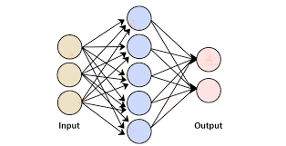
Introduction
Developed countries are improving the security system particularly in Cyberattacks and network security threats.
Over a decade, the number of malicious incidents have dramatically increased.
What is Artificial Neural Network(ANN).
What is Anomaly.

Slide 4
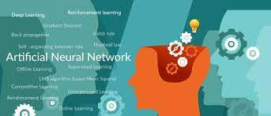
Existing Work
Facial Recognition
Signature Verification and Handwriting Analysis
Social Media
Image Processing and many more

Slide 5
Proposed Work
Dataset: ASNM(Advanced Security Network Metrics) Dataset
What is anomaly detection?
Artificial Neural Network(ANN) Sequential model

Slide 6
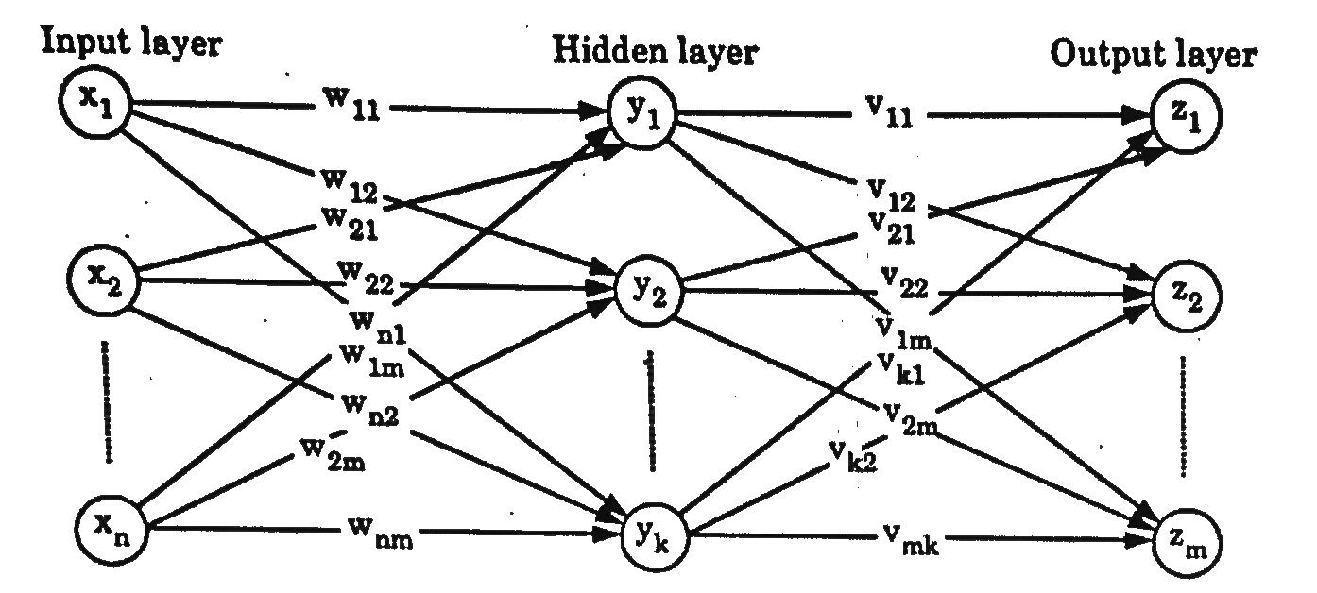
System Architecture Diagram
What is Neural Network?
We have made a Neuron network on Multilayer Feedforward Network

Slide 7
Continued…
Here the activation function serves two notable purposes:
For first 8 layers, we have “reLU” function(rectified linear activation function), that will output the input directly if it is positive, otherwise, it will output zero
For the output layer, we have used “Sigmoid” Function, can serve to convert the model's output into a probability score
Sigmoid function : On = 1 / (1+exp(-Fn))(On is the output from ‘n’ layer, which is the input for the ‘n+1’ layer).
Where F is the W1*X1 + W2*X2 + W3*X3 + …...... + Wn*Xn (w = weight, X = input)
Output for the last term i.e.(On term) should be between 0 and 1. A value closer to 1 (e.g. 0.75) indicates that there is a higher indication of anomalies.

Slide 8
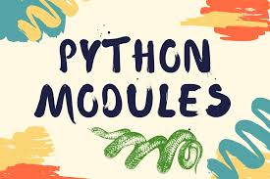
Modules used:
Pandas: For reading the dataset
Numpy: For arrays manipulation
Sklearn: for label encoding as well as stuffing and to split the dataset into training and testing part, accuracy score, precision score, f1_score, recall score, ROC curve and AUC
Tensorflow: in order to implement neural network
Matplotlib: used for visualization of data

Slide 9
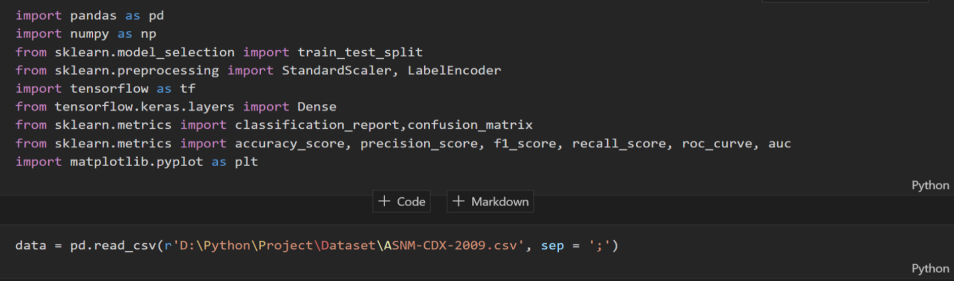
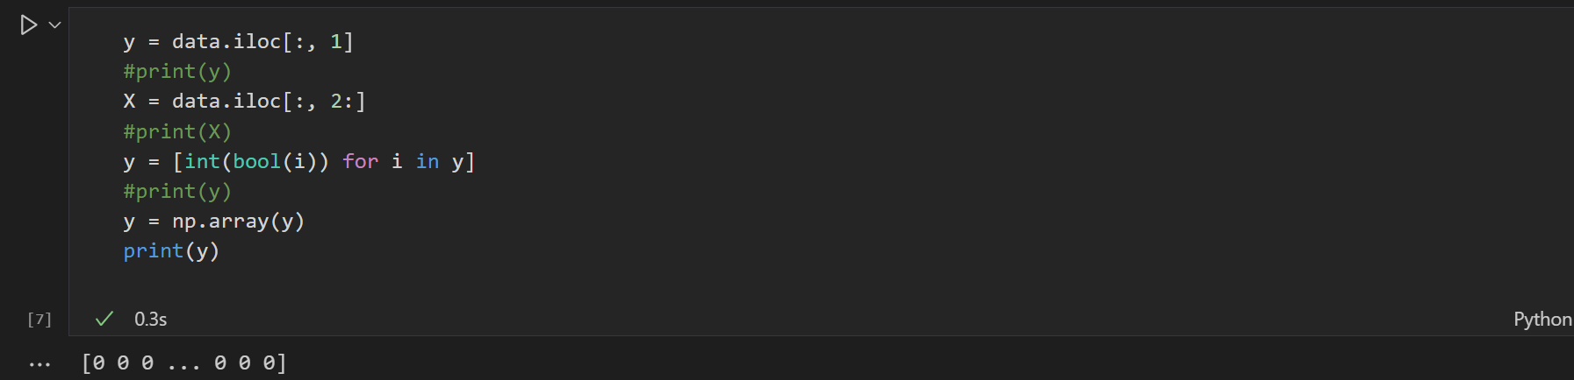
Modules Explanation with implementing Results.
1. Program using ASNM-CDX 2009 Dataset

Slide 10
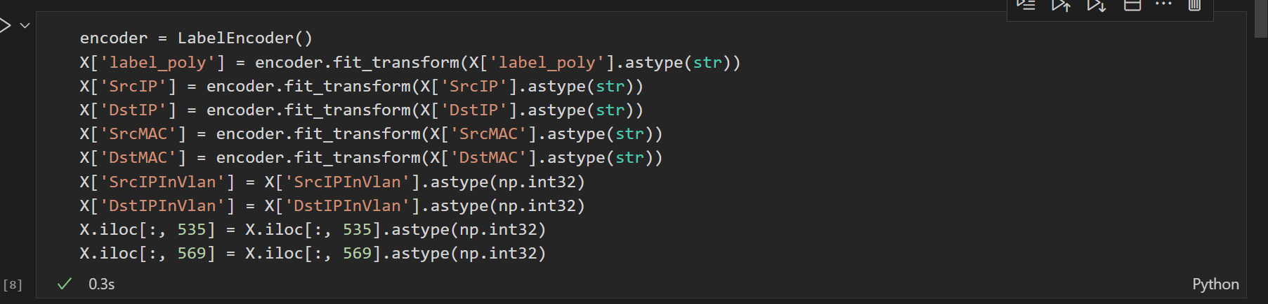
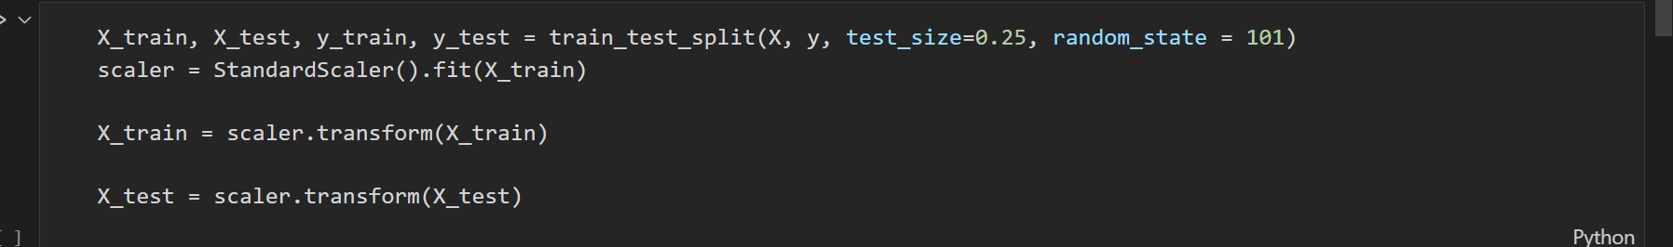
Continued..

Slide 11
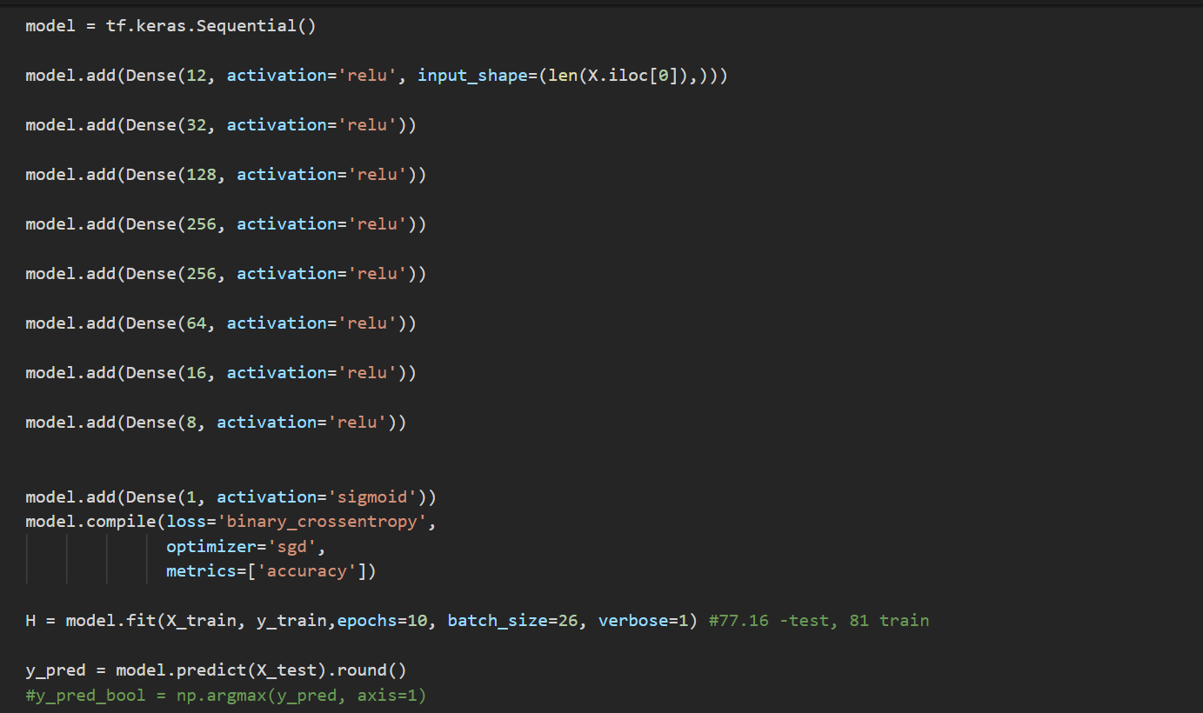
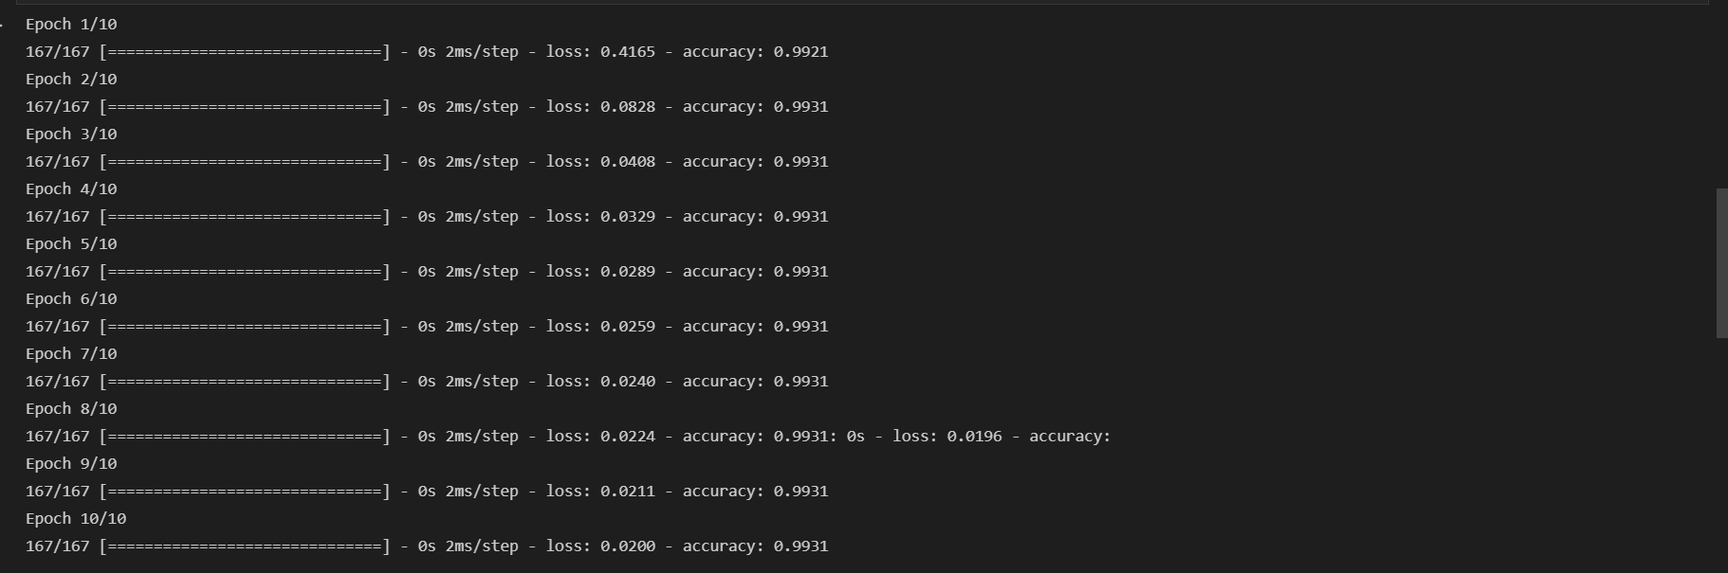
Continued

Slide 12
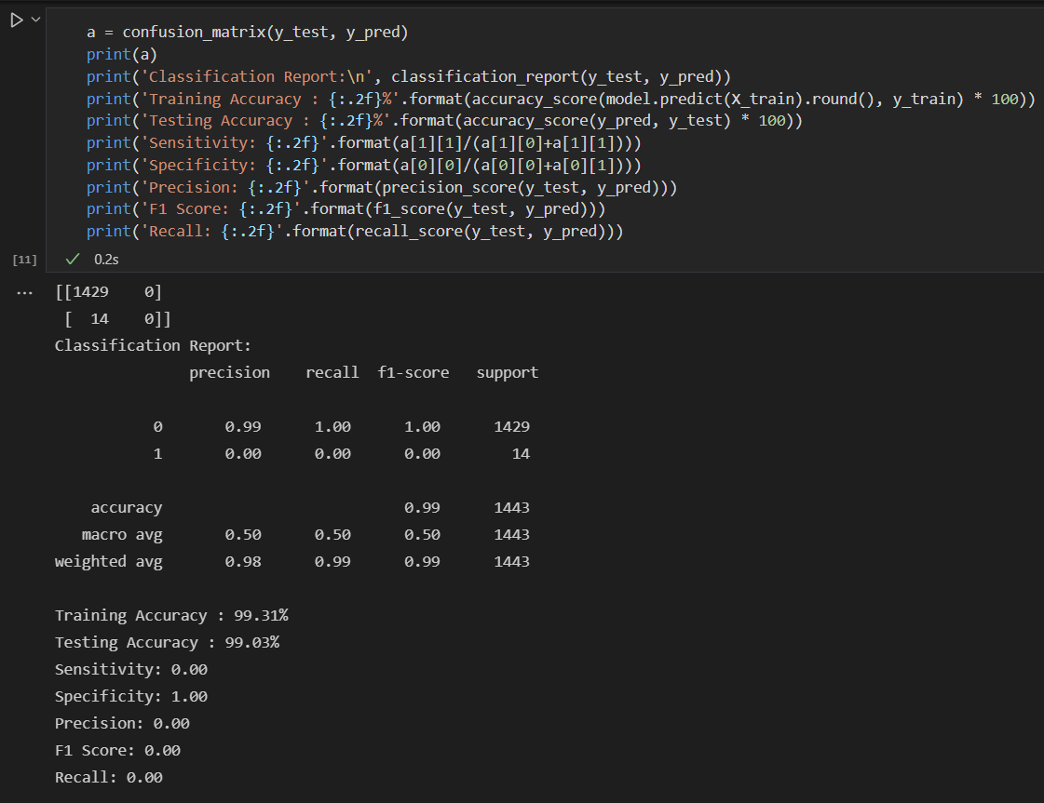
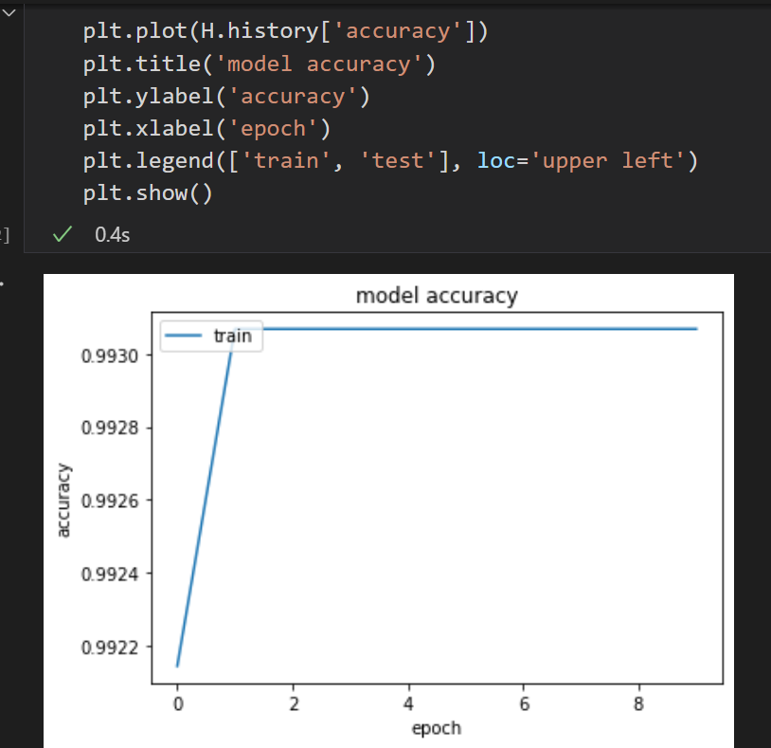
Continued…

Slide 13
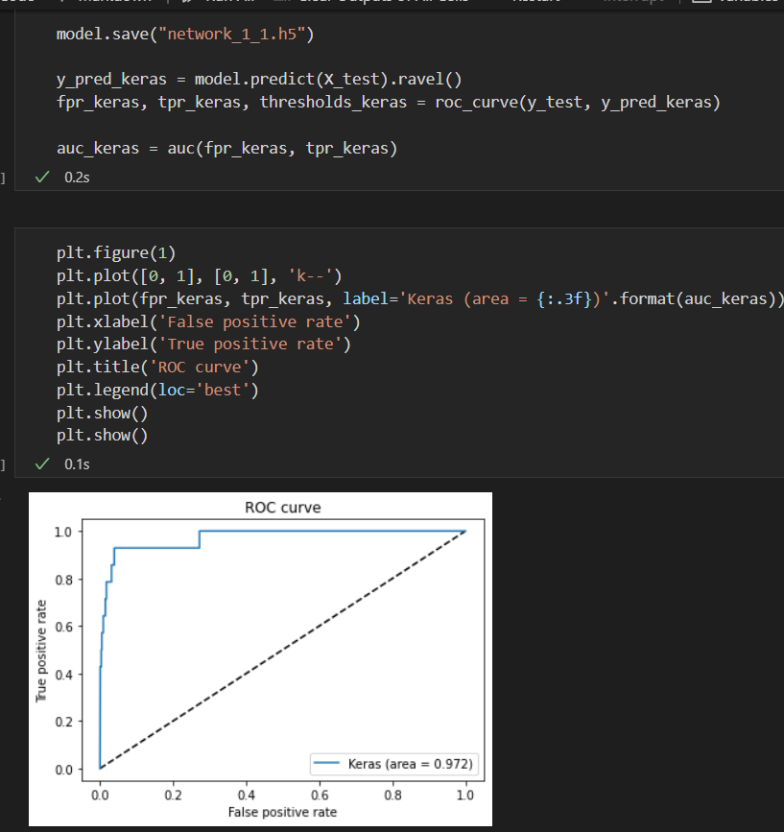
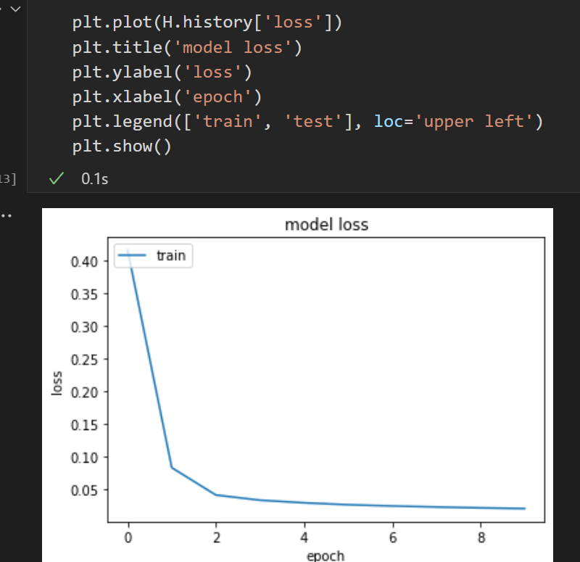
Continued…

Slide 14
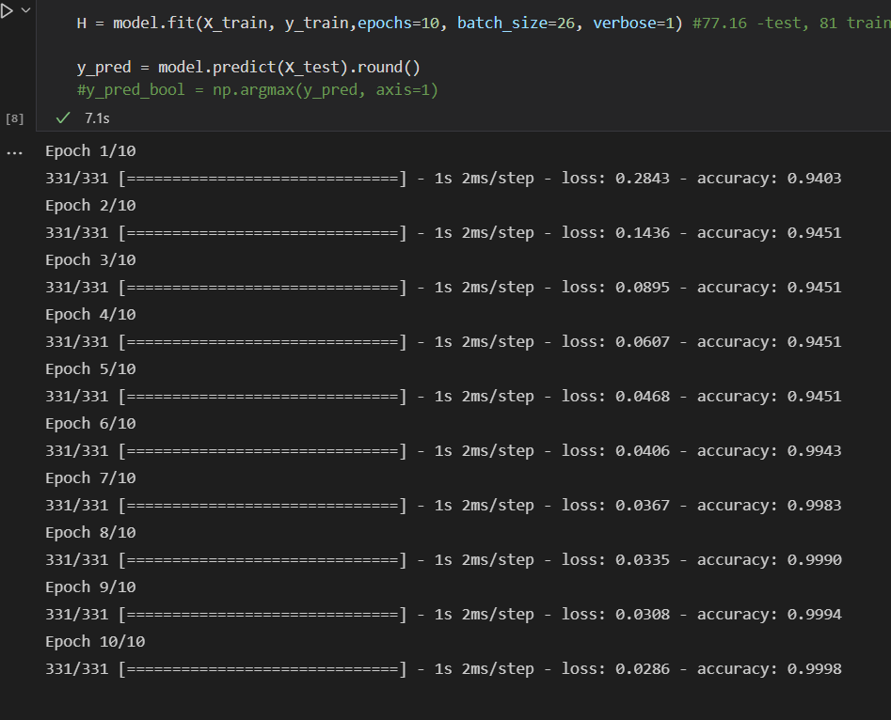
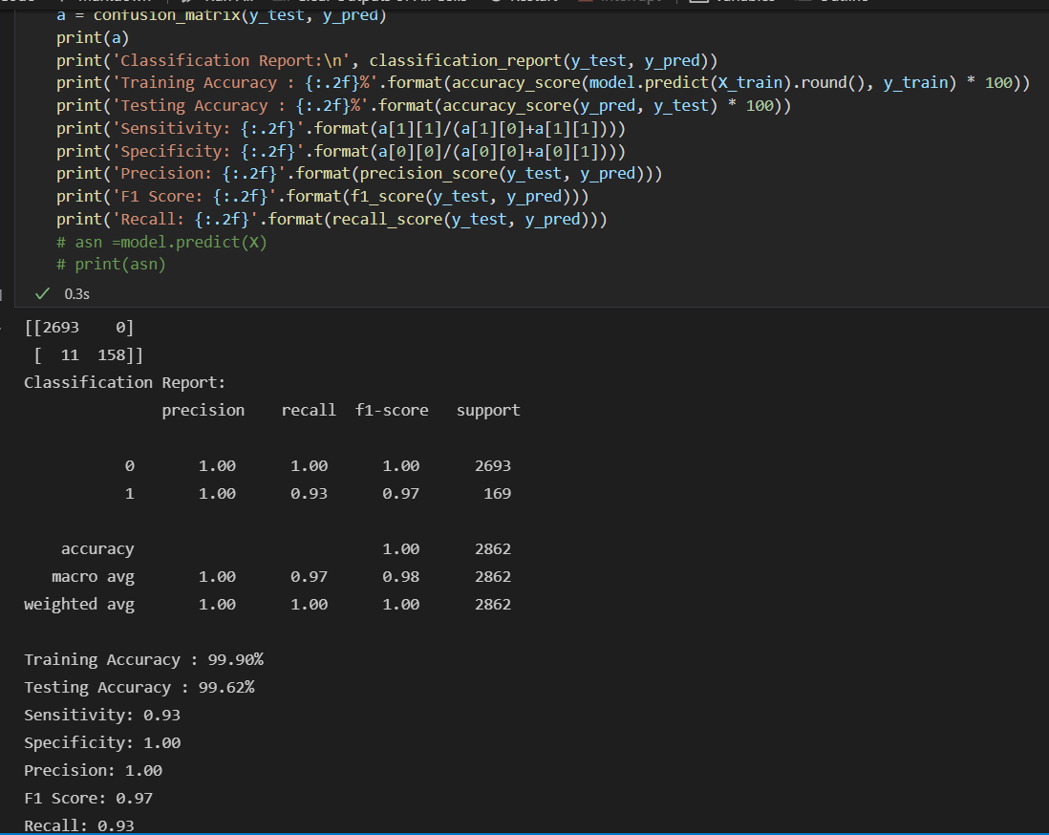
Continued…
2. Program using ASNM – NBPOv2 Dataset

Slide 15
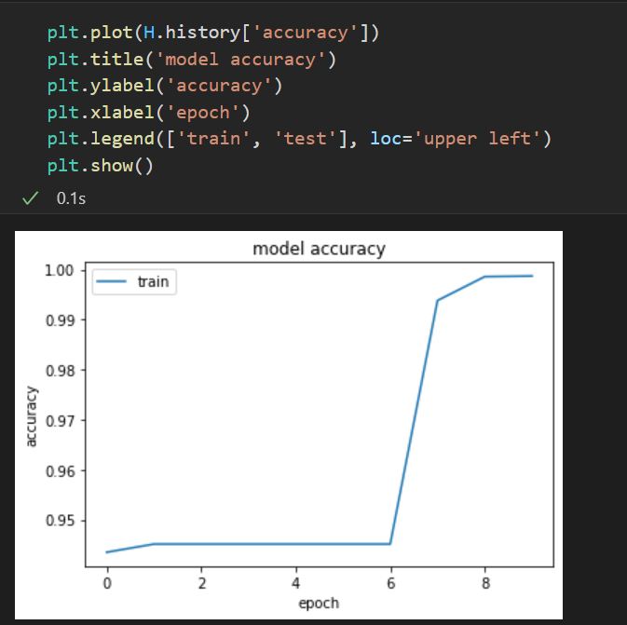
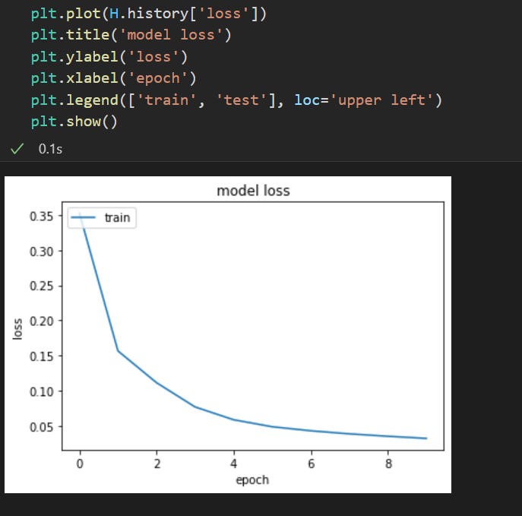
Continued…

Slide 16
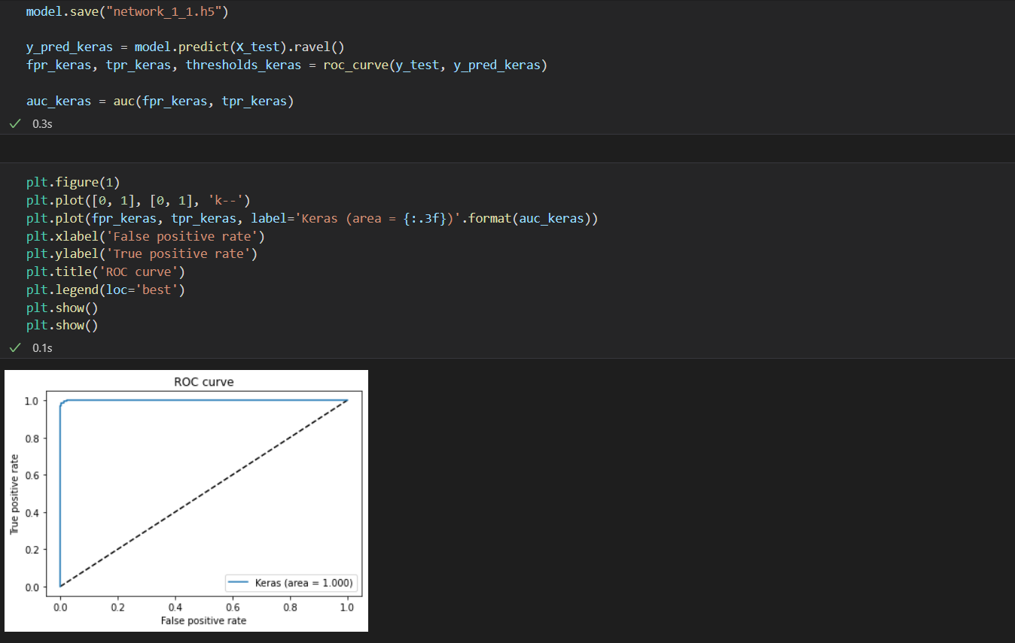
Continued…

Slide 17
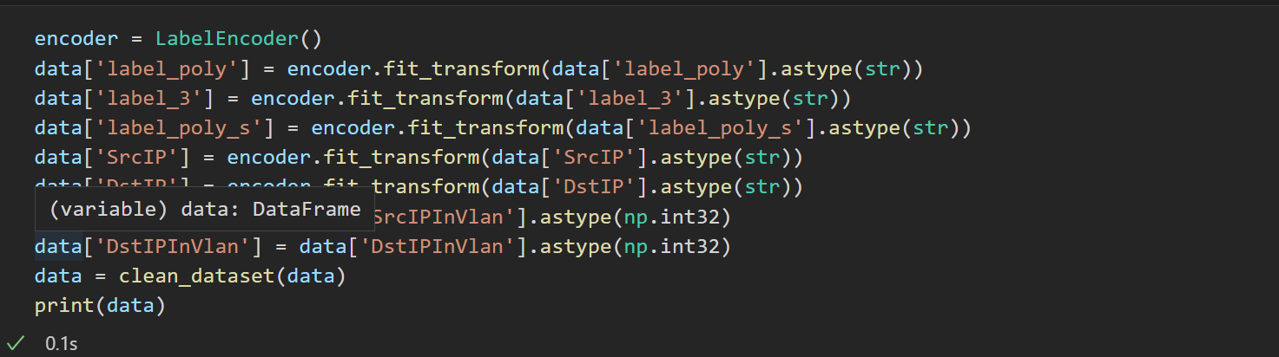
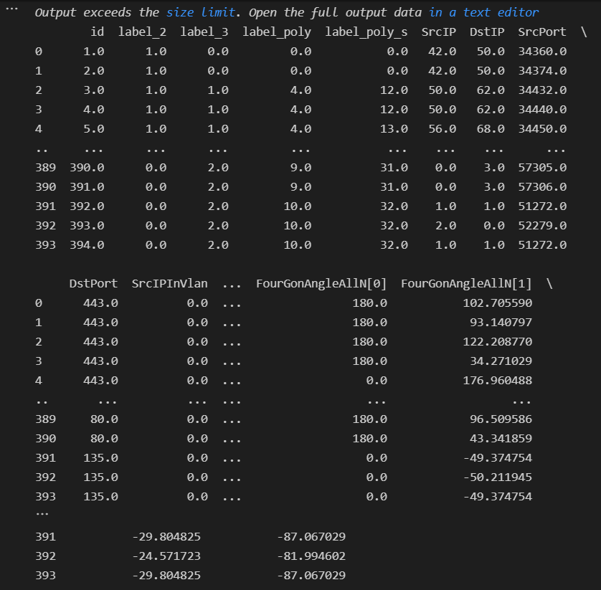
Continued..
3. Program using ASNM – TUN dataset

Slide 18
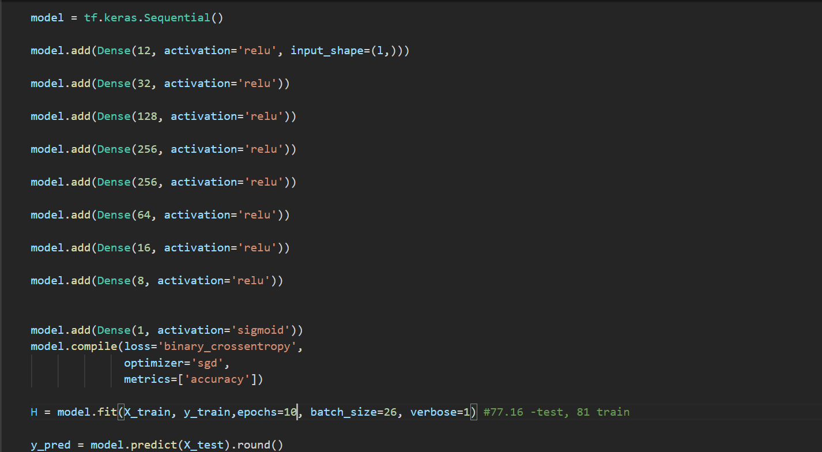
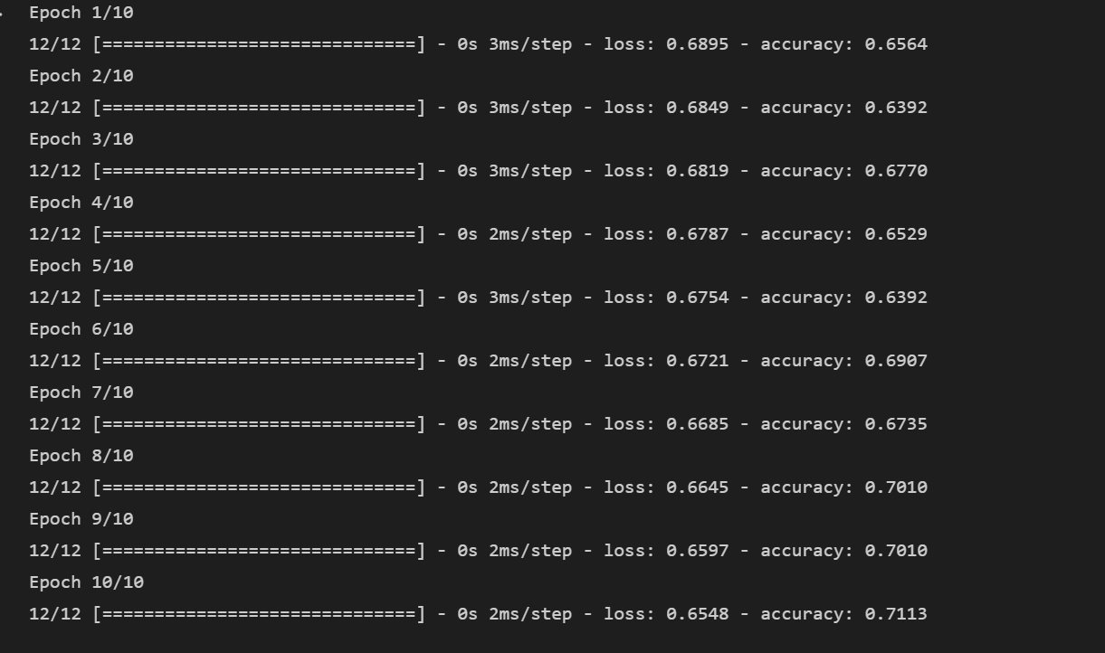
Continued…

Slide 19
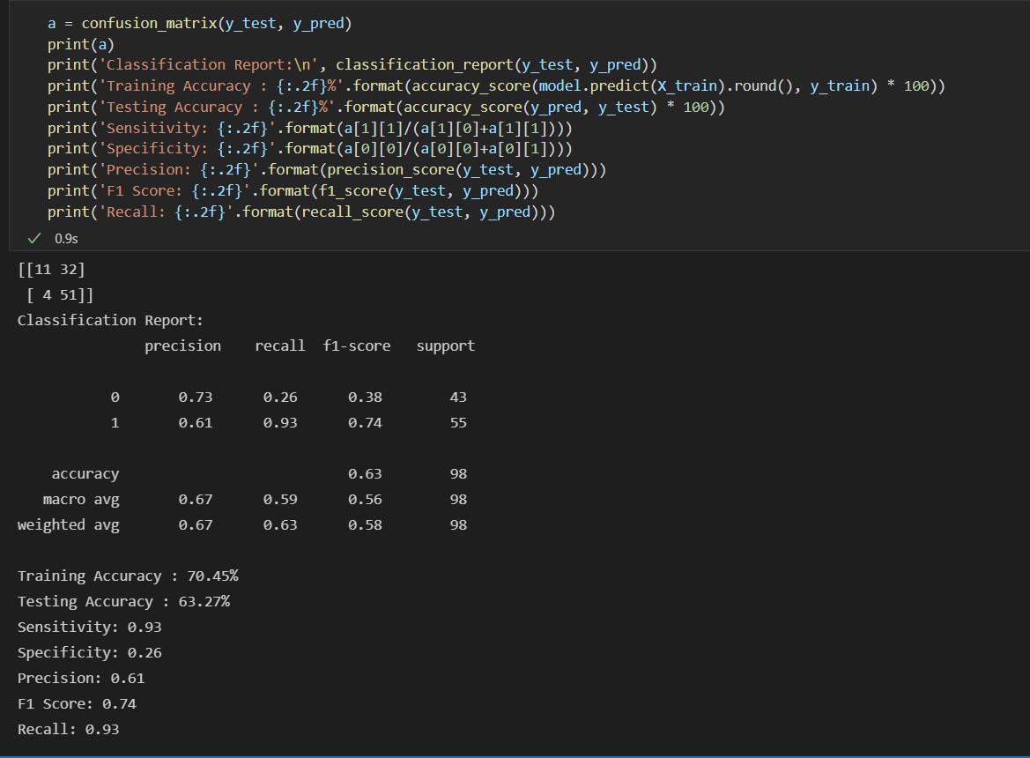
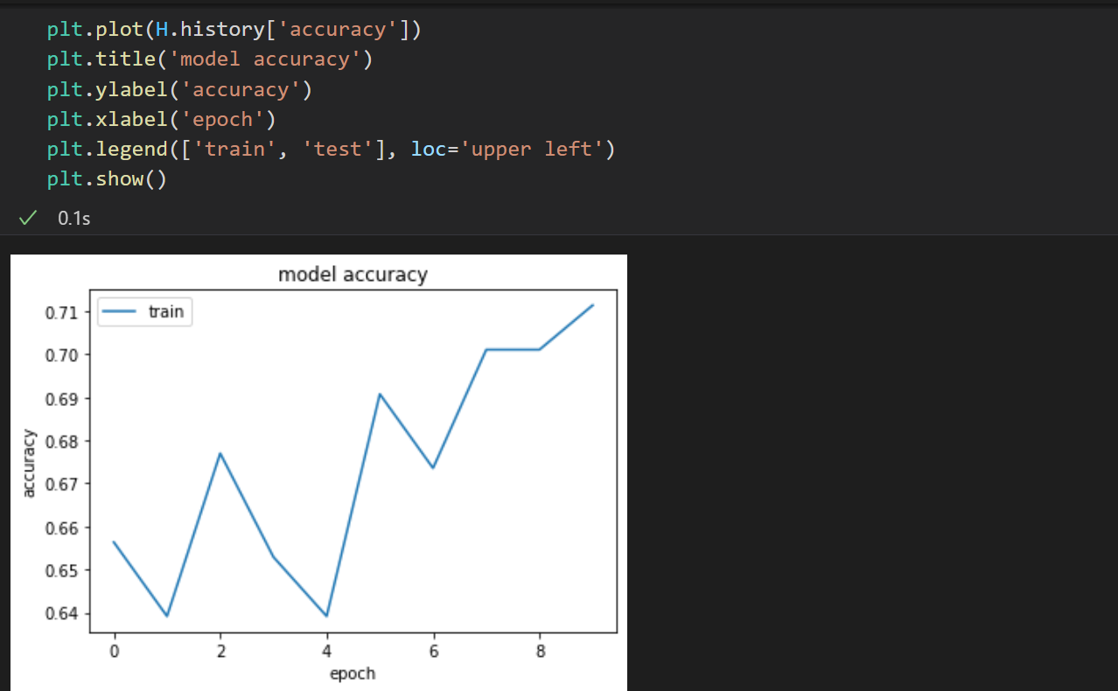
Continued…

Slide 20
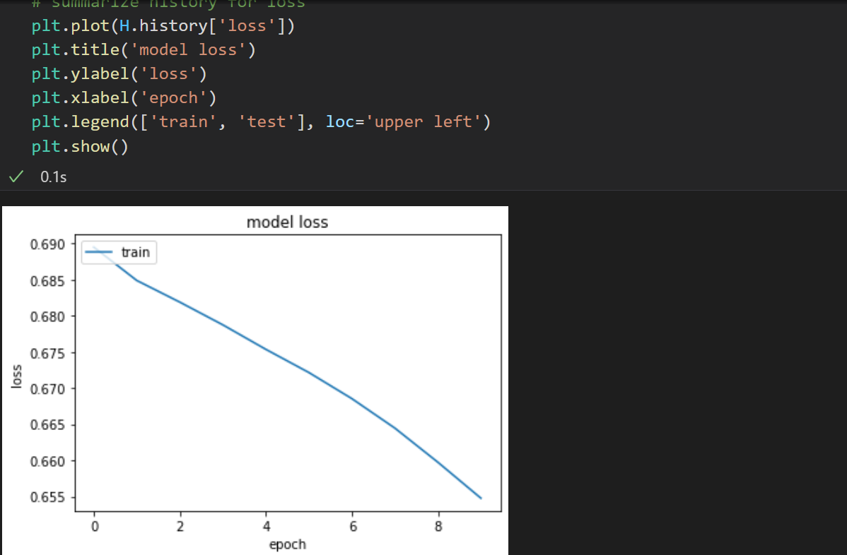
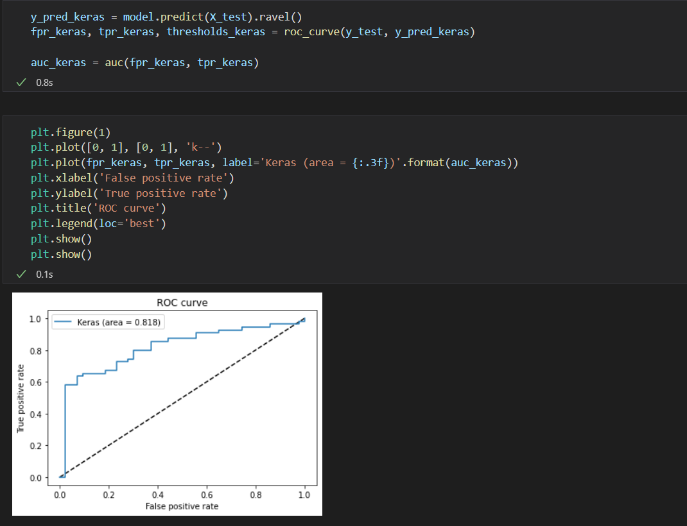
Continued…

Slide 21
References
https://ieeexplore.ieee.org/document/9115004
http://www.fit.vutbr.cz/~ihomoliak/asnm/
https://www.edureka.co/blog/what-is-a-neural-network/
https://towardsdatascience.com/introduction-to-neural-networks-advantages-and-applications-96851bd1a207#:~:text=Artificial%20Neural%20Network(ANN)%20uses,complex%20patterns%20and%20prediction%20problems.
https://www.ijitee.org/wp-content/uploads/papers/v8i9/I7914078919.pdf
https://www.mdpi.com/1099-4300/23/5/529
https://www.analyticssteps.com/blogs/8-applications-neural-networks
https://www.xenonstack.com/blog/artificial-neural-network-applications
https://towardsdatascience.com/building-our-first-neural-network-in-keras-bdc8abbc17f5

